Slide 1
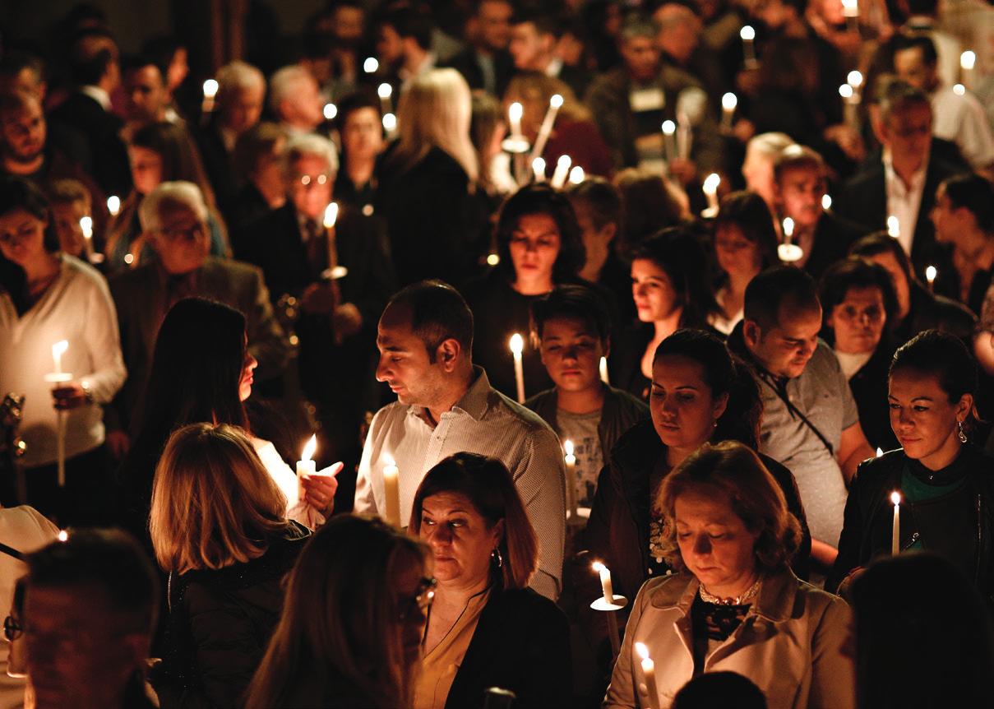

STAND WITH THE PERSECUTED CHURCH
CHURCH LIGHT WALK & PRAYERS IN THE DARK
Two simple ways for your church to carry light into the darkness — in solidarity with believers who worship in secret, and at great personal risk.
VOICEOPC.ORG
Notes:
Welcome. Tonight we're introducing two simple things our church can do to stand with persecuted Christians around the world — the Church Light Walk, and Prayers in the Dark.

Slide 2

LIGHT IN THE DARKEST PLACES
Across the world today, countless Christians live out their faith in places of danger and hostility. Some are forced to worship in secret; many face suffering, hardship and loss.
Yet in that darkness they keep living for Jesus — and shining as Christ's light in the darkest places.
Notes:
Set the theme. Across the world, Christians live out their faith in danger — yet they keep shining. They are Christ's light in the darkest places.

Slide 3
WORSHIP UNDER THE COVER OF DARKNESS
IN SECRET
AT NIGHT
AT GREAT PERSONAL RISK
For many believers, meeting to worship is neither simple nor safe. Some gather in hidden places. Some face threats, harassment, prison or violence — because they will not deny the name of Jesus Christ.
Notes:
Why darkness? For many believers, meeting to worship is neither simple nor safe — in secret, at night, at great personal risk, because they will not deny the name of Jesus.

Slide 4
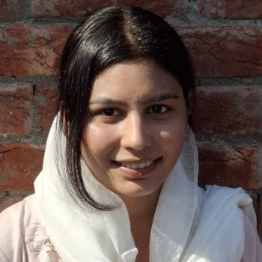
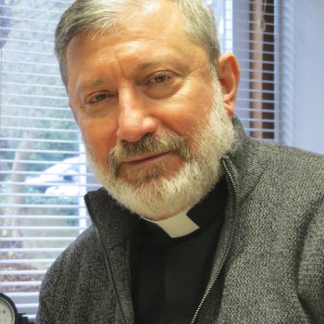
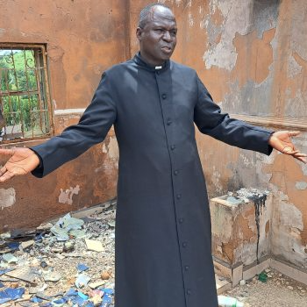
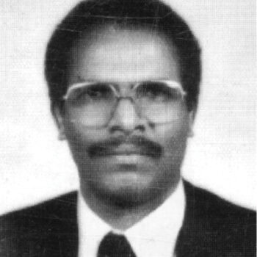
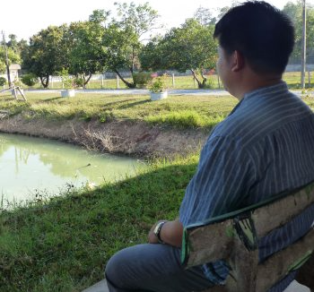
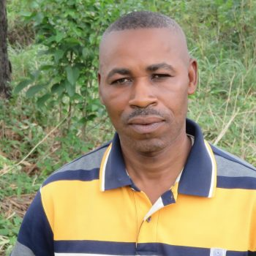
CHRIST'S LIGHT IN THE DARKEST PLACES
Meet a few of our brothers and sisters
Severa
Rev. Faiz
Rev. Mark Mukan
Dr Kiflu
Pastor Phouang
Luka
Pakistan
Iraq
Nigeria
Eritrea
Laos
Nigeria
Notes:
Meet a few of our persecuted brothers and sisters. These are real people, in real danger, still shining for Christ.

Slide 5
SEVERA · PAKISTAN
Rejected, but still shining
In Pakistan, many consider it shameful to be associated with Christians. Severa faces deep-rooted discrimination at university — made to sit at the back of lectures while other students physically distance themselves from her. Despite the rejection, her faith is strong, and she has started a group to encourage other Christian students.
Notes:
Severa, in Pakistan, faces deep-rooted discrimination at university for her faith — yet she is starting a group to encourage other Christian students.

Slide 6
REV. FAIZ · IRAQ
Light for a troubled city
In Iraq, sectarian tensions run high, Christians are treated as second-class citizens, and violent attacks are a continual risk. Rev Faiz leads a church in Baghdad that is committed to serving the Christian community — and shining Christ's light into this troubled city.
Notes:
Rev Faiz leads a church in Baghdad, committed to serving the Christian community and shining Christ's light into a troubled city where violent attacks are a continual risk.

Slide 7
REV. MARK MUKAN · NIGERIA
Darkness won't have the last word
In Nigeria, thousands of Christians have been killed and many more forced from their homes, leaving profound suffering and loss. But Rev Mark Mukan will not allow this awful darkness to have the last word. He is committed to pastoral care, and to training more Christian leaders to reach out with the transforming light of the gospel.
Notes:
In Nigeria, thousands of Christians have been killed. Rev Mark Mukan will not let that darkness have the last word — he is training Christian leaders to carry the gospel forward.

Slide 8
DR KIFLU GEBREMESKEL · ERITREA
Twenty years in a prison cell
In Eritrea, Dr Kiflu Gebremeskel has spent more than 20 years in the darkness of a prison cell. A senior leader in the Eritrean church, he was one of the first targets of the country's authoritarian regime. Despite severe pressure, he has never denied his faith in Christ.
Notes:
Dr Kiflu Gebremeskel has spent more than 20 years in an Eritrean prison cell. A senior church leader, he was one of the first targets of the regime — yet he has never denied his faith.

Slide 9
LUKA · NIGERIA
Forgiveness after the darkest night
In Nigeria, Luka lived through one of the darkest nights of his life when militants attacked his village and killed his wife, his parents and his children. After trauma counselling, Luka has committed to forgiving the attackers — and to using his life to bless others.
Notes:
Luka lost his wife, parents and children when militants attacked his village. After trauma counselling, he has committed to forgiving the attackers and using his life to bless others.

Slide 10
PASTOR PHOUANG · LAOS
Forced to pray after dark
In rural Laos, Pastor Phouang has devoted his life to sharing the gospel with a minority people group. Many have come to faith in Jesus — but they face strong opposition. To avoid being detected, they are forced to meet together outside their village, after dark, to pray.
Notes:
Pastor Phouang's story is the bridge to Prayers in the Dark — his church in Laos is forced to meet outside the village, after dark, to pray.

Slide 11
Two ways to stand with them
Both raise the voice of persecuted Christians — in prayer, compassion and practical support.
01
02
CHURCH LIGHT WALK
PRAYERS IN THE DARK
Walk through the darkness together, carrying light — a visible act of solidarity with the persecuted church, and a witness to the church at home.
Gather to pray in the dark, as many believers are forced to do — and hold them before God, wherever they are tonight.
Notes:
So here are two simple ways we can stand with them. Both raise the voice of persecuted Christians in prayer, compassion and practical support.

Slide 12
THE IDEA
THE CHURCH LIGHT WALK
Show a visible act of solidarity: organise and publicise a walk in the darkness. It is also a witness to the church here at home — a call not to forget the suffering body of Christ, but to stand with persecuted Christians in prayer, compassion and practical support.
Notes:
What is a Church Light Walk? A visible act of solidarity — a walk in the darkness carrying light. It's also a witness to the church here at home.

Slide 13
Organise your own Light Walk
Choose a spring or autumn evening — and make yourselves shine.
1
Talk it over with your church or small group, and get the leaders on board.
2
Pick a start time when it is dark, and plan a route of 1–2 miles.
3
Promote the walk and encourage people to sign up to take part.
4
Ask everyone to bring torches, lanterns or phones — light to carry as you walk.
5
Pause to pray for persecuted Christians before you set out and along the way.
6
Take photos to share with us — and plan the route so everyone stays safe.
Notes:
Six simple steps to organise your own. Get leaders on board, pick a dark evening, plan a short route, promote it, everyone brings a light, and pause to pray along the way.

Slide 14
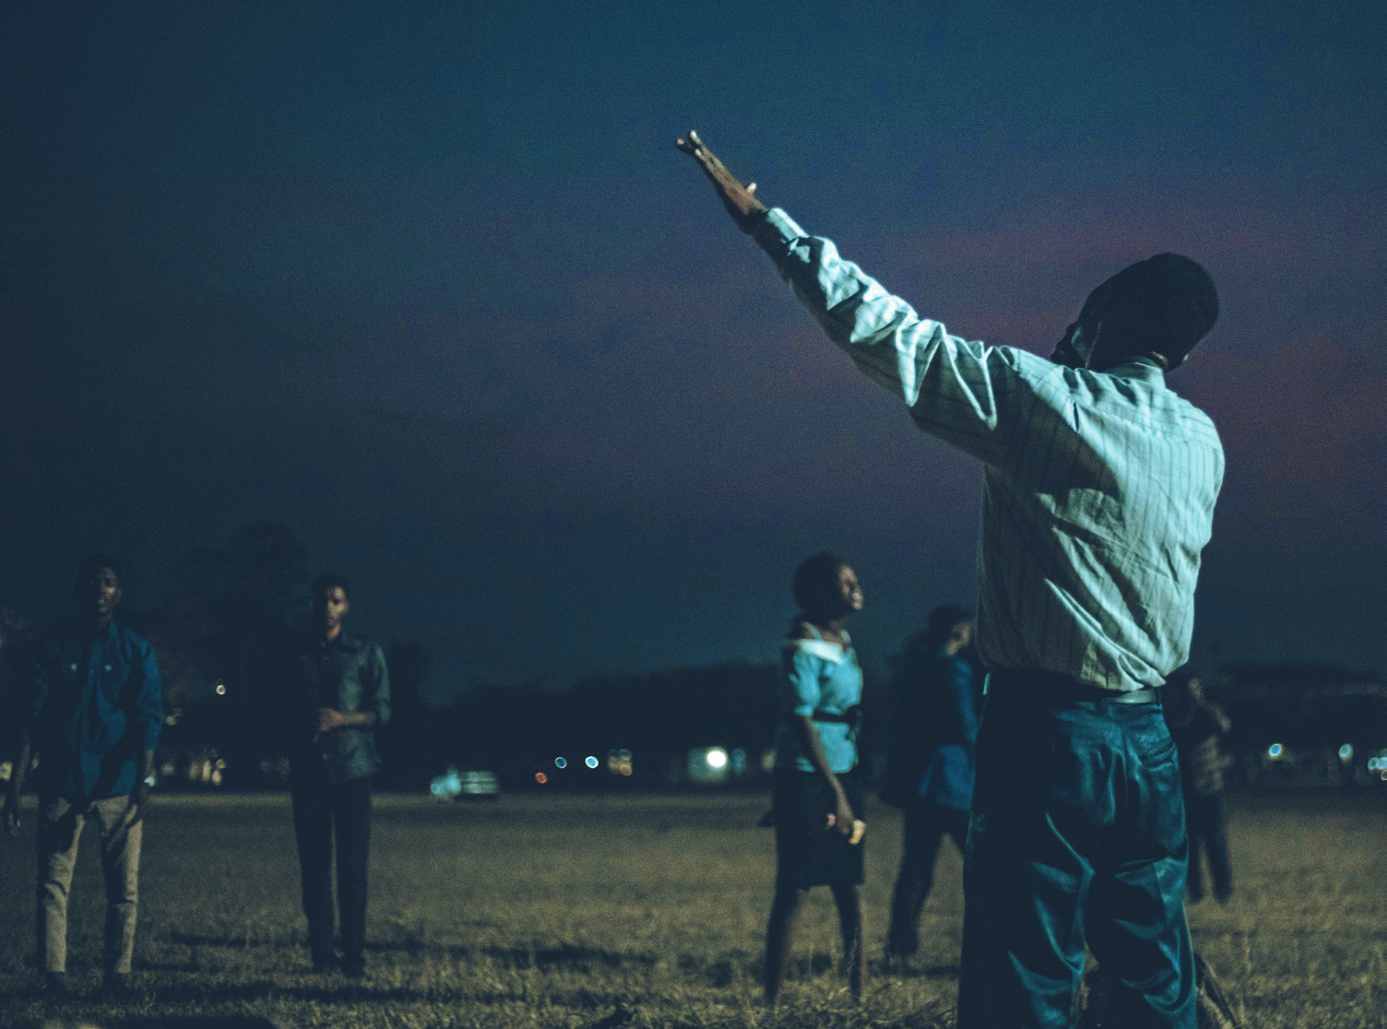
THE IDEA
PRAYERS IN THE DARK
In many parts of the world, Christians must meet in secret — often under the cover of darkness, as Pastor Phouang's church does in Laos. Identify with them: gather, switch out the lights, and pray for those forced to worship this way.
Notes:
What is Prayers in the Dark? Identify with believers who must meet in secret. Gather, switch out the lights, and pray for those forced to worship this way.

Slide 15
Hold your own Prayers in the Dark
A dedicated evening, or a slot in a regular prayer meeting.
1
Talk it over with your church or small group, and get the leaders on board.
2
Choose a dark evening, or add a slot to a regular prayer meeting or service.
3
Invite people, and ask them to bring a torch, phone or small individual light.
4
Give some direction on how to pray — use our Prayer Shield and Voice material.
5
Switch out the lights, and pray for those forced to meet in the dark.
6
Take a photo to share with us — and keep everyone's safety in mind.
Notes:
Six steps. Get leaders on board, choose a dark evening or use a regular meeting, invite people with a small light, guide the prayer, switch out the lights, and share a photo with us.

Slide 16
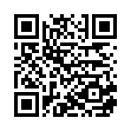
STAND WITH THEM. RAISE THEIR VOICE.
Organise a Light Walk. Hold Prayers in the Dark. Stand with the persecuted church — and share your photos with us. We'd love to celebrate what you do.
VOICEOPC.ORG
Scan to find out more & get involved
Notes:
Close on the call to action. Organise a Light Walk. Hold Prayers in the Dark. Stand with the persecuted church — and share your photos with us.

